Slide 1

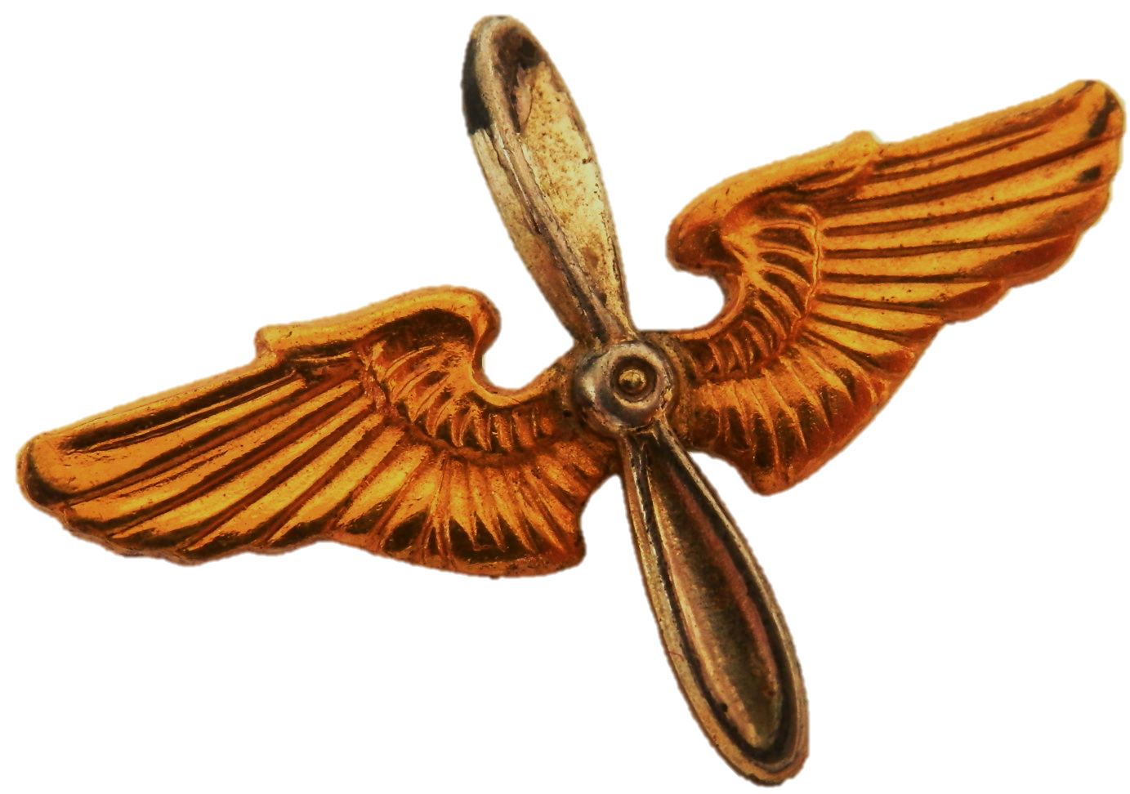
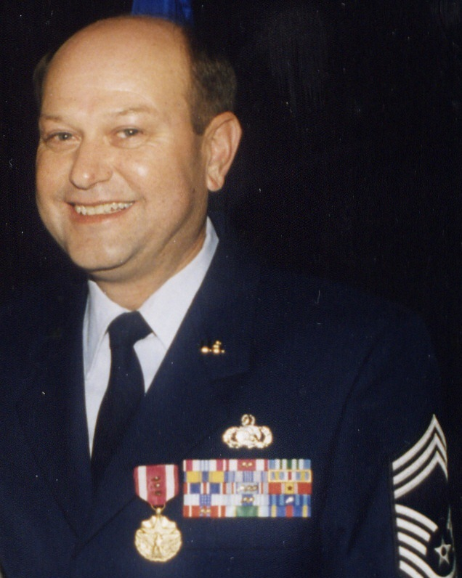
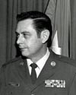
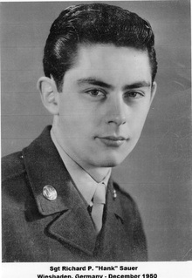
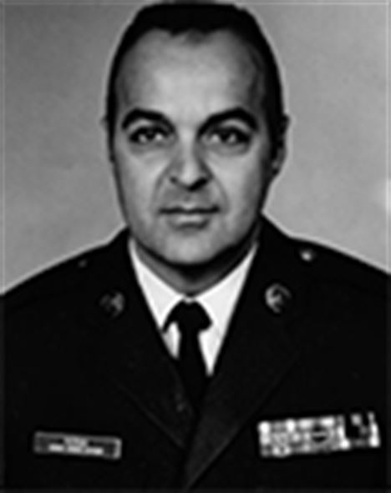
Enlisted
Communicators in History
CMSgt Larry V. Holifield
A true visionary, Chief Holifield, in his role as the career field manager, created the model for the Air Force’s expeditionary-minded comm-unications squadron. He rallied the force to operationalize and professionalize the network, a concept central to today’s cyber workforce.
To change pictures:
Save the picture of the person you wish to use.
Single-left-click the grouped picture/shapes you wish to change on the poster. Single-left-click again on the picture.
Now single-right-click the picture and select “Change Picture” from the menu.
Choose the picture file you saved.
You may wish to single-left-click the grouped picture/shapes and single-left-click the new picture again to adjust its size or crop it—especially useful if the new picture is not the same aspect ratio as the previous one.
DO NOT CHANGE PROP AND WINGS PICTURE!!!
CMSgt Richard P. “Hank” Sauer
Chief Sauer became a cryptologic operator and served in support of the Berlin Airlift during WWII. In the 70s, he rose through the ranks in industry, eventually becoming the chief of computing and tele- communications in the Department of Energy.
CMSgt Laurence Patrick
Chief Patrick served in the communications field for 47 years—he was a Morse intercept operator in his early years, and later as an AUTODIN switch center superintendent, he held the world record for overseas switch operational efficiency at 100% uptime for 66 consecutive days.
How will you leave your mark on the cyber operations domain?

